Slide 1


DEAL HUNTER
INTRODUCTION
Mentor by : Satyajeet Saaho Coordinator by : Arathy Pillai

Slide 2


INTRODUCTION
The project focuses on automating the collection of online deals using web scraping techniques. It aims to provide users with a consolidated, user-friendly platform to easily access and explore offers from various e-commerce websites.
Problem statement

Slide 3


Problem statement
Work flow
Finding deals across multiple e-commerce platforms is time-consuming and inefficient.
Manual searches often miss frequent updates, leading to lost opportunities. No unified platform exists for easy deal comparison.
Objective:
Automate deal aggregation and present it through a user-friendly interface for a seamless shopping experience.

Slide 4




WORK FLOW
4 .
Displaying the
data
3 .
Cleaning and
processing
2 .
Extracting relevant
data
1.
Identifying target
website

Slide 5

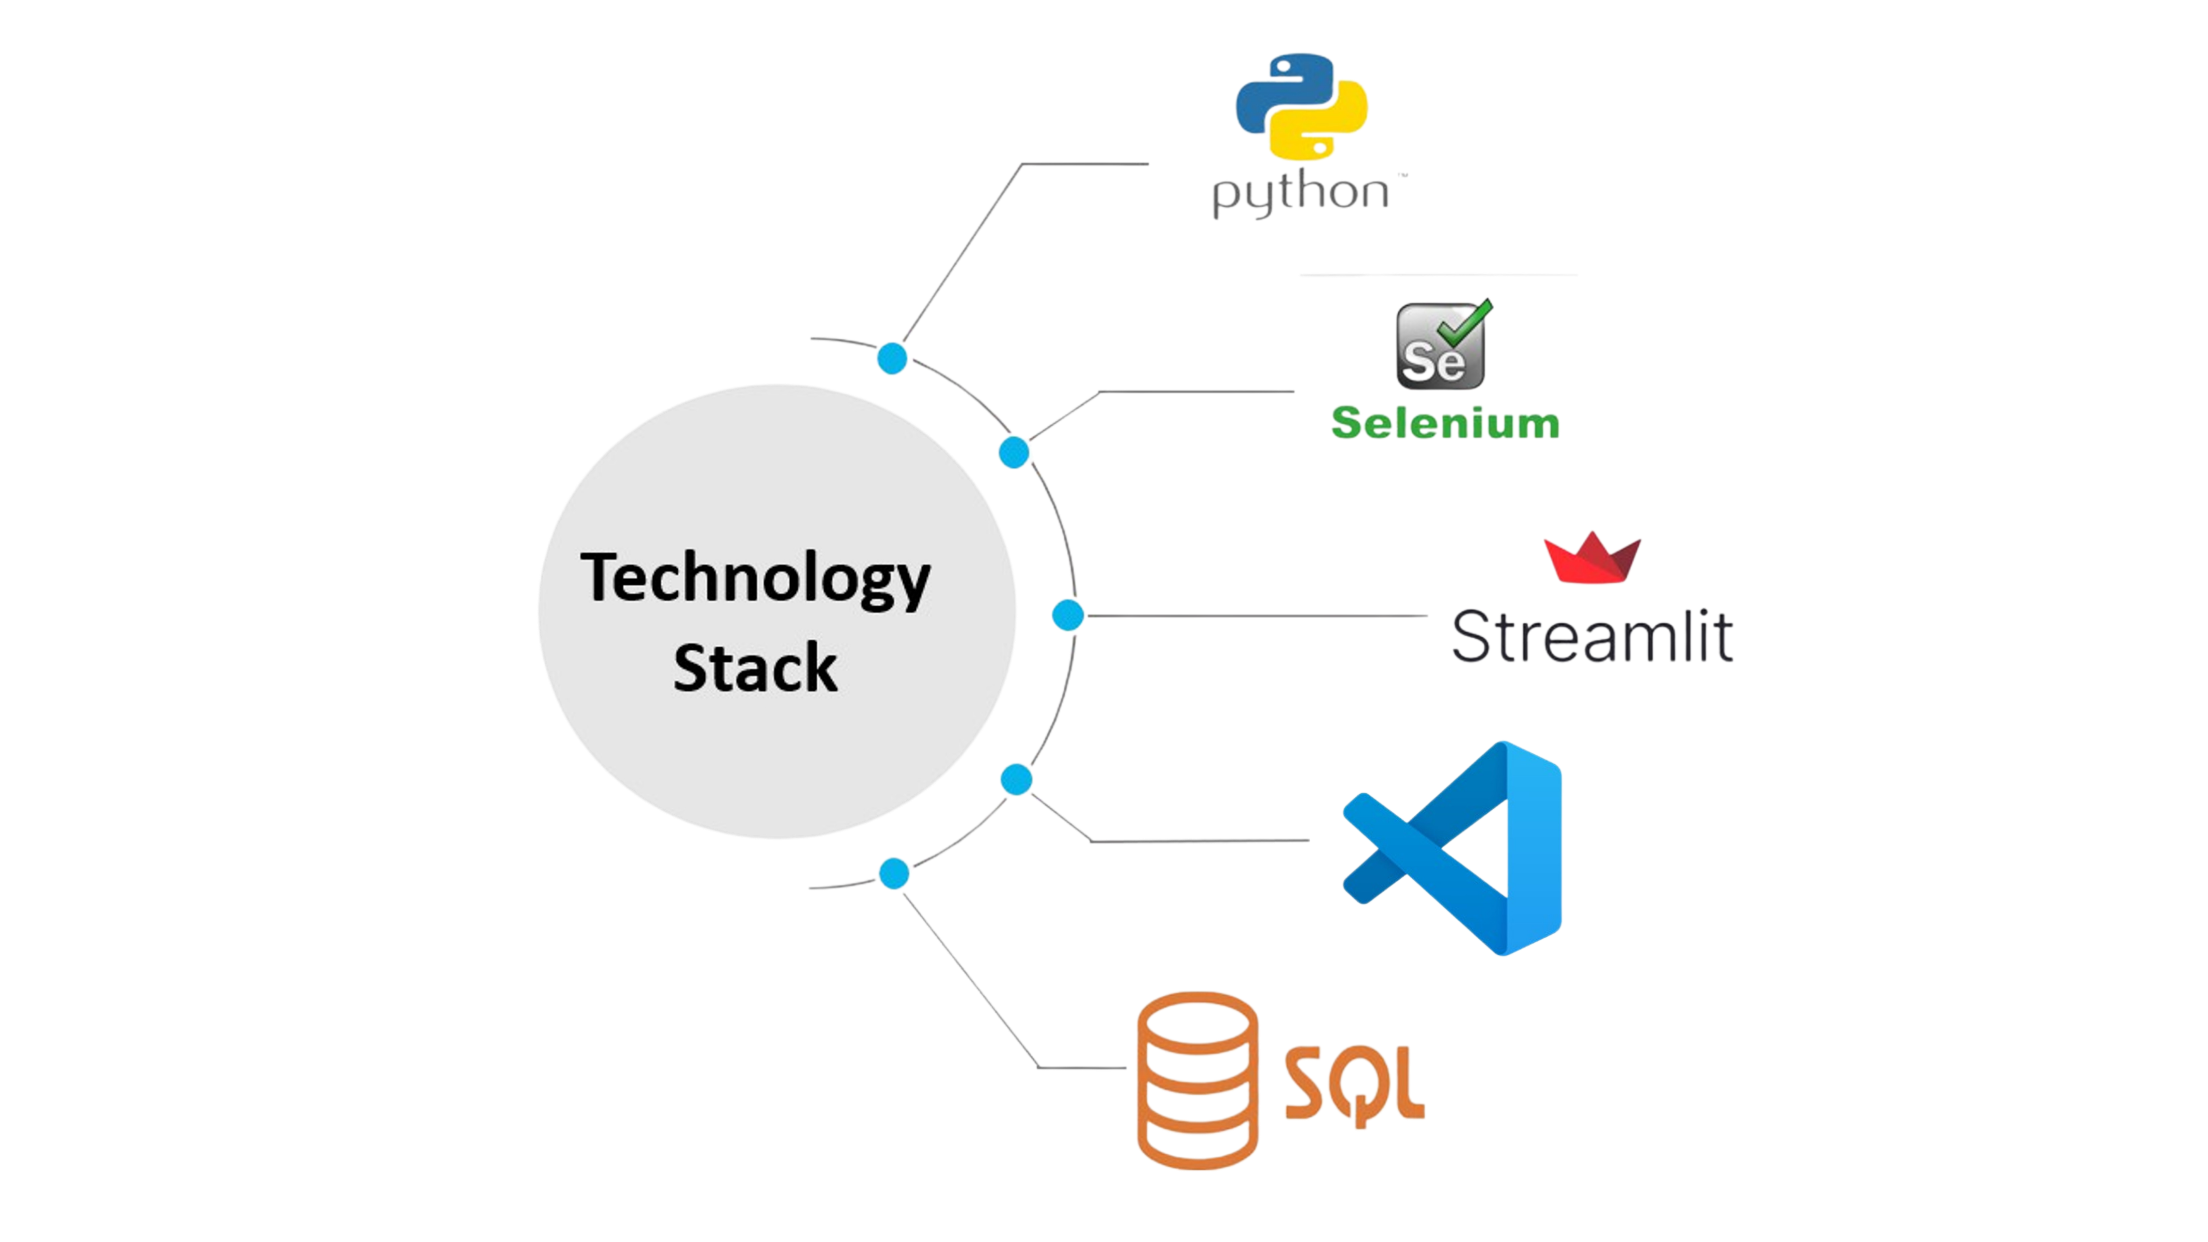





Slide 6


CHALLENGES & SOLUTIONS
Challenges Faced:
Dynamic content loading on websites. Managing bot detection mechanisms.
Data consistency and formatting issues.
Solutions Implemented:
Used Selenium to handle dynamic web pages. Introduced delay mechanisms to mimic human browsing. Applied data cleaning techniques for uniformity.

Slide 7










FUTURE SCOPE
Multi Language Support
User Account and Personalization
Robust Backend
Real Time Updates

Slide 8



CONCLUSION
This project demonstrates the power of web scraping in real-world applications.
It combines simplicity and functionality, offering a hands-on approach to data extraction

Slide 9

THANK YOU

